Slide 1
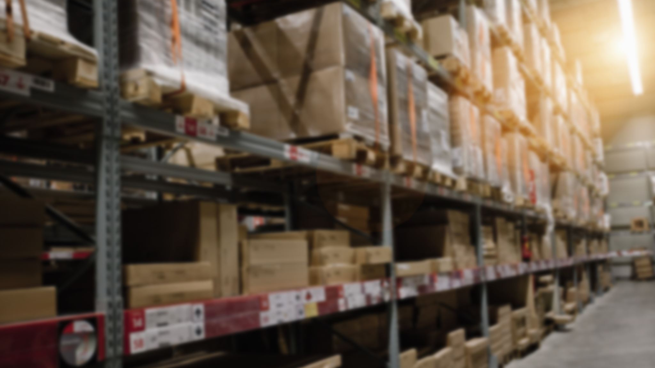
Superstore Sales Overview
By:
Sreepriya Meerel

Slide 2

Project Scope:
To develop a Power BI report for a superstore sales dataset to gain valuable insights into sales trends and aid in enhancing sales performance.

Slide 3
Obtain and Load the Dataset:
Acquired the superstore sales dataset in a compatible format( Excel).
Imported the dataset in Power BI Desktop.

Slide 4
Transform and Clean the Data:
Power Query Editor was used
Removed duplicates
Handled missing or null values
Created calculated columns (e.g., Total sales, Shipping Delay etc.) using DAX

Slide 5

Create the Data Model:
Defined relationships between tables (e.g., orders, products, customers) based on common keys(Order ID,Region).
Ensured appropriate cardinality and cross-filtering direction for relationships.

Slide 6

Create Visualizations:
The appropriate visualization types was chosen based on the dataset and analysis goals (e.g., bar charts, line charts, pie charts, etc.).
Visualizations were created by dragging and dropping fields from the dataset tables.
Legends were added.
Tooltip was created.

Slide 7
Arrange & Format the Visualizations:
Arranged and resized the visualizations to create a visually appealing layout.
Created slicers and filters to allow users to interact with the data dynamically.
Adjusted formatting options like colors, fonts, titles, and backgrounds to match your desired aesthetic.
Applied a theme to maintain a consistent look and feel across the dashboard.

Slide 8

Conclusion:
Sales exhibit a consistent uptrend from 2015 to 2018.
The Technology Category stands out with the highest sales.
The Central region remarkably contributes to a major share of sales, accounting for 58.5%.
Emily Burns, leading the Central region, demonstrates exceptional performance.
The French market appears promising for the store's products.
The Red Hoover Stove emerges as the top profit generator.
Standard shipping is the preferred choice for most consumers, despite an average delay period of 7 days.
It is noteworthy that Standard shipping proves to be the most profitable option, accounting for 61.65%.
In terms of Office Supplies, although there is a slightly higher shipping delay, this category offers substantial discounts.

Slide 9
Recommendations:
Enhanced Marketing Strategies
Optimize Pricing Strategy
Inventory Management
Collaborate with Suppliers to improved profit margins.
Collect Customer Feedback and survey
Community Involvement to increase brand awareness
Improve Customer Service.
Regular Sales Training and Incentives to staff.
Expand Product Range based on market demands and trends.
Utilize Cross-Selling

Slide 10

Thank you

